Slide 1
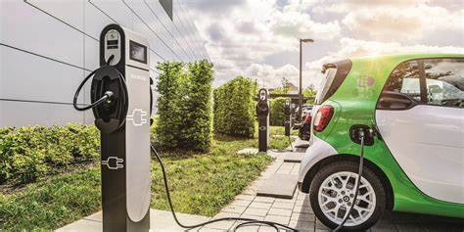
ELECTRONIC VEHICLE CHARGING STATION LOCATOR
​
Presented by: PROTOMINDS

Slide 2
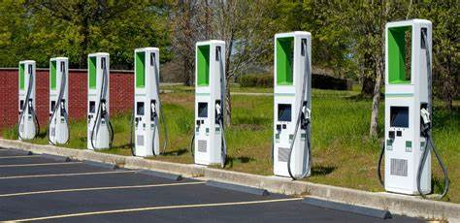
HOW DOES AN EV CHARGING STATION WORK?
Electric vehicle(EV) charging station are an integral part of owning an (EV).
All electric cars don’t have a gas tank – rather than filling your car up with gas, you simply plug your car into its charging station to fuel up.

Slide 3
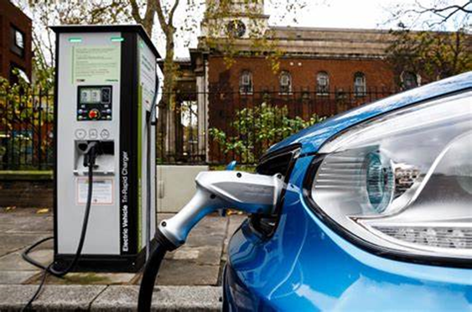
Is ev charging is free?
On the other hand ,electric vehicle charging costs are not nearly as clear. Some EV charging stations require payment by hour, dispensing however much energy the car can take during that time, they are charging stations that use a per session fee, and a bunch of charging stations are free.

Slide 4
Where to find ev chargers?
EV chargers are scattered in many places and are run by various companies. Finding them can be a challenge for the average consumer. Having a way to find all EV chargers in one app or website will be helpful. We are trying to make an app which uses an opensource API which provides charger locations and navigate the user to them.

Slide 5





EV Charger locator
location
Find Stations
Find nearEst stations
Provide navigation
Go and charge!
Take the location of the user using GPS or manual input
Find the locations of nearby charging stations using openchargemap API
Calculate the one closest to the user
Navigate the user to the station
Use the charger to charge the vehicle and be on the way.

Slide 6
SUMMARY
EVs will be used more and more in the future so to further encourage the adoption of them finding chargers will help them as no one wants to be stuck on the road. This solution uses openchargemap API and find the nearest chargers and helps them navigate there without being stuck with no charge.

Slide 7
THANK YOU
P. Thrayambakeshwara Prasad
T. Nishanth
A.Sai Karthik
S. Shanthi Kumar

